Slide 1
Keypad Security System
Group 25 Members: William Presley and Jay Hayes

Slide 2
Project Description
We will launch the program and ask the user to either enter a new passcode or set up the alarm system. If the alarm system is set up we will wait for movement to be detected using ultrasonic sensor and sound off the alarm when this occurs. Until the user enters the correct passcode the alarm will continue to sound.

Slide 3
Required Parts
LCD display
Keypad membrane switch
Ultrasonic sensor
Piezoelectric buzzer
Microchip Curiosity development board
Arduino Uno
4 10 kΩ resistors

Slide 4
Parts Description
LCD Display & Membrane Switch - Used for UI
Ultrasonic Sensor - Used for motion sensor
Piezoelectric Buzzer - Used for alarm tone
Microchip Curiosity development board - Used for:
Main program and UI handler
Output to LCD
Arduino Uno - Used for:
Input from Membrane Switch (to reduce pin usage on Microchip Curiosity)
Input from Ultrasonic Sensor
Output to Piezoelectric Buzzer
10 kΩ resistors are used for pull-up resistor setup

Slide 5
Design & Testing Process
Verify that all the individual components are functioning properly
Test the desired functionality from each component (while separated from each other)
Combine all components into a single program that handles user and data input in the manner described in our flowchart.

Slide 6
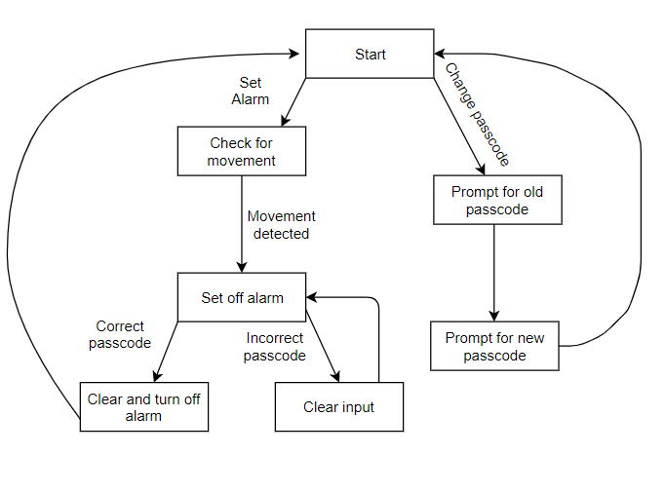
Flowchart

Slide 7
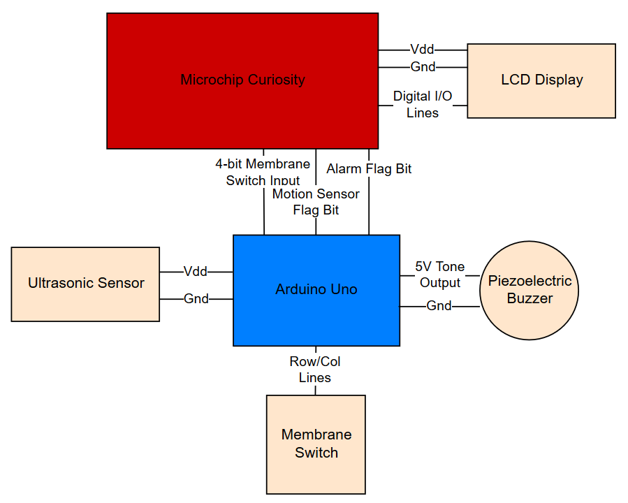
Block Diagram

Slide 8
Issues
Available pins on Microchip Curiosity
Pull-Up resistors for inputs
Hardware Issues (membrane switch and LCD)

Slide 9
LCD Display Code
Major Functions:
InitSysUI() - Clears screen and gives options for setting alarm and password.
fiveSecCountDown() - Displays the countdown for setting the alarm.
writeKey(int key) - Displays proper characters.
Microchip Curiosity Function
Arduino Uno Function

Slide 10
Membrane Switch Code
Major Functions:
getPressed() - Gets the button pressed on membrane switch.
sendKeyPressed() - Sends 4-bit binary value to Microchip Curiosity for button pressed.
getMemInput() - Converts binary value from Arduino Uno to key value for Microchip Curiosity.
Microchip Curiosity Function
Arduino Uno Function

Slide 11
Ultrasonic Sensor Code
Major Functions:
getDist() - Gets distance from ultrasonic sensor.
setFlag() - Sets flag if distance changes below specified value.
main() - Uses flag from Arduino.
Microchip Curiosity Function
Arduino Uno Function

Slide 12
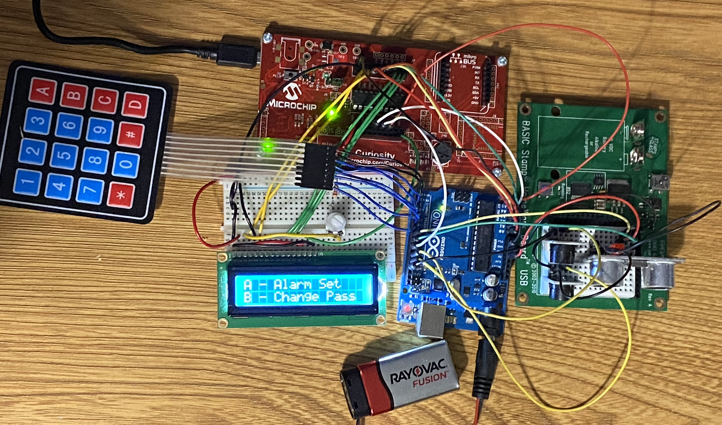
Final Circuit & Live Demo

